Slide 1


SMART INDIA HACKATHON 2024
TITLE PAGE
Problem Statement ID – SIH1638
Problem Statement Title- AI-Driven Crop Disease Prediction and Management System
Theme- Agriculture, FoodTech & Rural Development
PS Category- Software
Team ID- N/A
Team Name – Lettuce Hack

Slide 2







Modular AI-Driven Crop Disease Management System
Lettuce Hack
Problem:
Difficulty in identifying crop diseases early, leading to reduced yields.
Challenges in using complex technology due to low digital literacy.
Lack of tools that work with low-end devices or poor internet connectivity.
Innovation and Uniqueness:
Dual Input Capability: Supports both text and image-based diagnosis for versatile use.
RAG-based Models: Fine-tuned for agricultural contexts, enhancing precision and relevance.
Ensembled Image Classifiers: Includes a zero-class for unidentified leaves, improving reliability.
Multi-Platform Access: Available via Android and web, catering to varying technical abilities.
Local Deployment: Ensures quick, cost-effective performance even with limited resources.
How It Addresses the Problem:
Combines text and image inputs for flexible, farmer-friendly disease diagnosis.
Revenue Model
Model | Pros | Cons | Verdict
Data Monetization | Scalable, valuable insights | Needs large user base, privacy risks | Long-term growth, high potential
Sponsored Content | Non-intrusive, steady revenue | Requires partnerships | Reliable with minimal user impact
Marketplace for Supplies | Direct sales, high demand | Complex logistics | High growth potential, scalable
Affiliate Marketing | Easy to implement, no user cost | Low revenue at first | Good as a supplementary stream
Agri-Lending Partnerships | Lucrative, valuable to farmers | Complex to set up | High value but takes time to build
Top Choices for Revenue Generation
Data Monetization
Sponsored Content
Marketplace for Agriculture Supplies

Slide 3
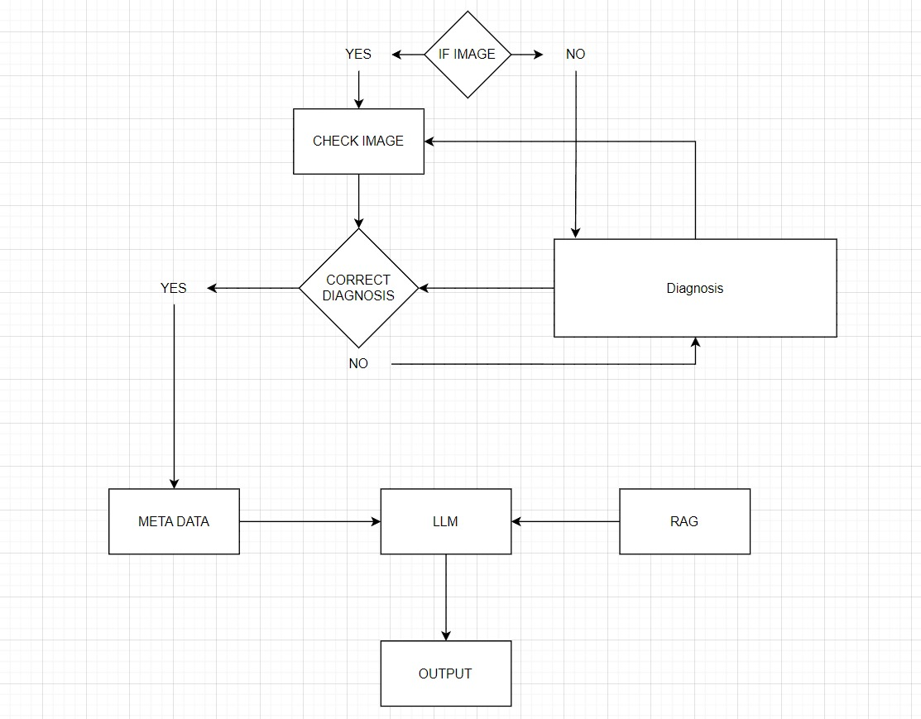
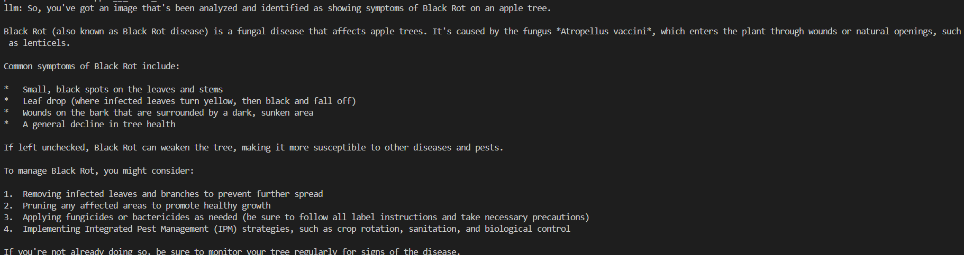





TECHNICAL APPROACH
Lettuce Hack
Technologies to be used:
Python - Ollama, LangChain, FAISS, PyTorch
Models - llama3.1:8b (llm), miniLM-L6-V2(for generating indeces), ensembled model [ResNet, VGG, Efficientnet]
Typescript, React Native, Firebase, Expo

Slide 4
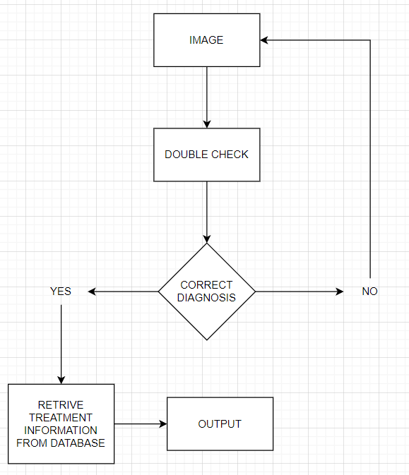
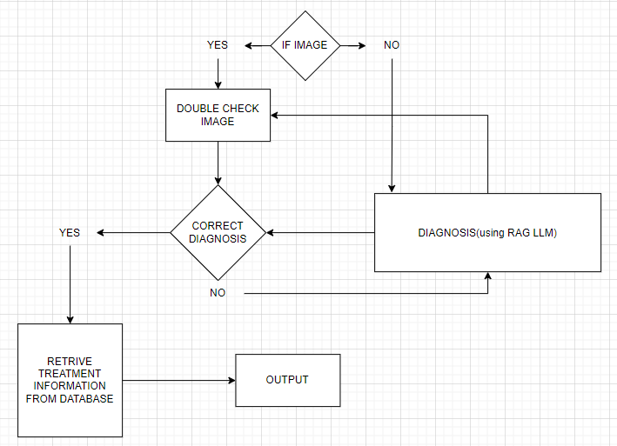
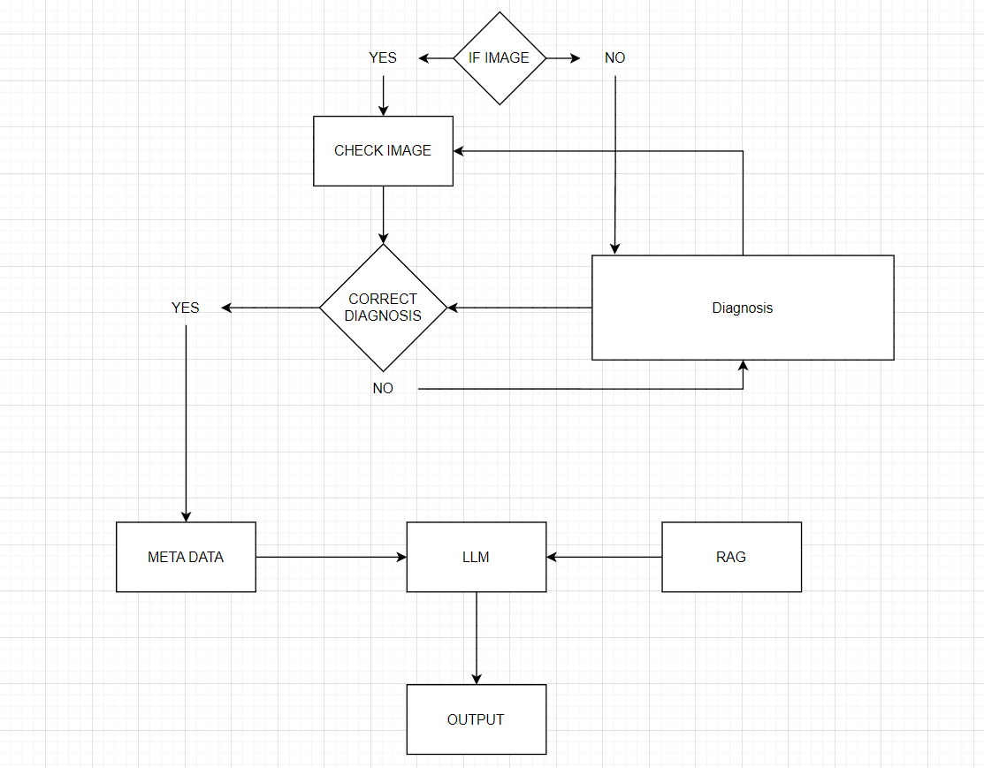
FEASIBILITY AND VIABILITY
Lettuce Hack
Stage - 1
Stage -2
Stage -3
The solution employs ensembled models (ResNet, VGG, EfficientNet) for robust image classification and RAG-based models for efficient query handling. Its modular design allows for staged deployment, This phased approach improves feasibility by enabling gradual resource allocation, early validation, and scalability.
Its highly viable die to its modular design, which allows for staged deployment, reducing the need for significant upfront investment. This step-by-step approach ensures that each phase can be tested, refined, and validated, minimizing risks while ensuring steady progress.

Slide 5
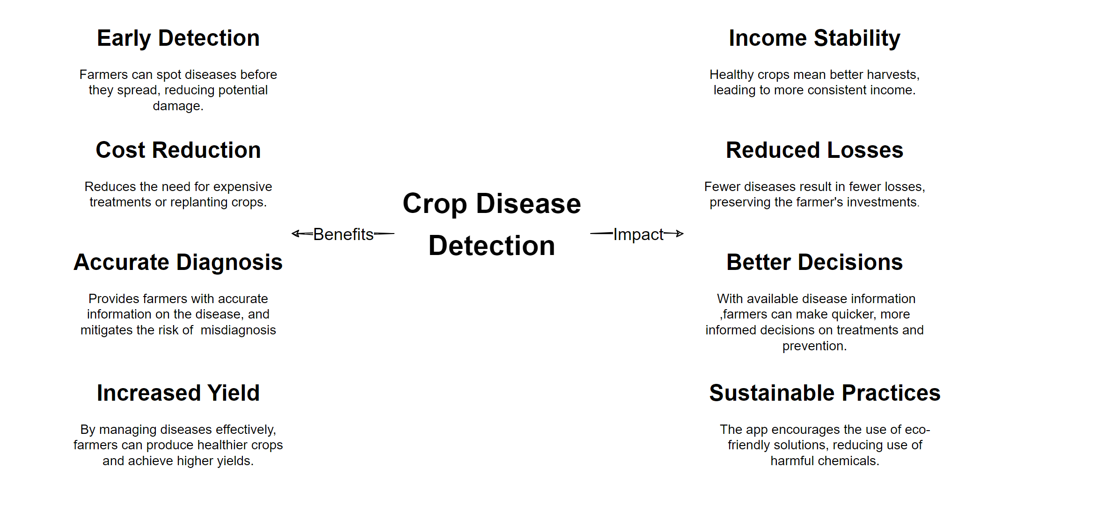
IMPACT AND BENEFITS
Lettuce Hack

Slide 6
RESEARCH AND REFERENCES
Lettuce Hack
Handling Zero-Class and Overconfidence:
Zero-Class: Techniques for managing zero-class (unknown samples) and ensuring accurate classification.
Overconfidence: Methods like temperature scaling and dropout reduce model overconfidence.
Source: Out-of-Distribution Detection and Classifier Calibration – IEEE Transactions on Pattern Analysis and Machine Intelligence.
Ensembling Models:
Ensembling: Combining models (ResNet, VGG, EfficientNet) improves accuracy and robustness by leveraging diverse strengths.
Source: Ensemble Deep Learning: Opportunities and Challenges – IEEE Access.
RAG Models:
RAG Efficiency: RAG models integrate retrieval and generation for efficient and accurate query handling with minimal fine-tuning.
Source: RAG: Retrieval-Augmented Generation – Facebook AI Research.

